Slide 1
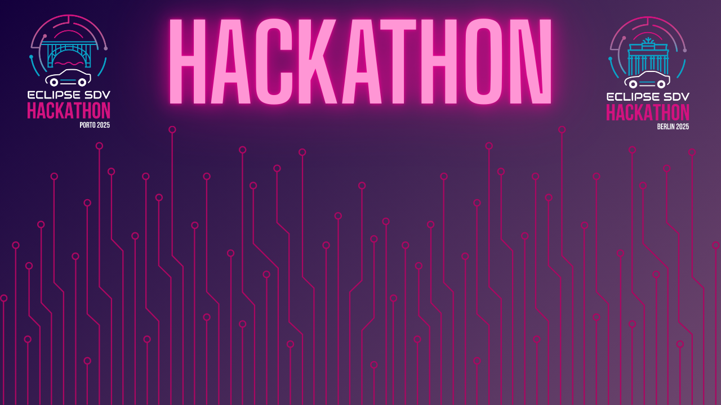

Chapter III - 2025
INTERNAL
COPYRIGHT (C) 2025, ECLIPSE FOUNDATION

Slide 2


The Journey to your Pitching
HACKING
30.09 & 01.10.2025
FIRST
EVALUATION
02.10.2025 | Evaluation done by the Coaches
Berlin: (10:30 - 12:00 CET) / Porto 09:30 - 11:00 (GMT+1)
Upload Pitch
Slides
Finish and Upload your own Pitch Slides to your own repo
until 02.10.2025 Berlin: (12:00 CET) / Porto 11:00 (GMT+1)
FINALIST
TEAMS
First Evaluation (Coaches) → List of the 7 Finalist Teams
PITCHING
SESSION
Pitching Presentations of the Finalist Teams
SECOND
EVALUATION
Second Final Evaluation (Jury) → The Winners (3rd, 2nd, 1st)
INTERNAL
COPYRIGHT (C) 2025, ECLIPSE FOUNDATION

Slide 3
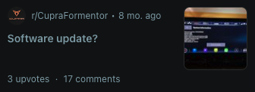
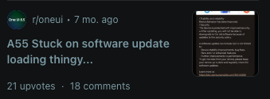
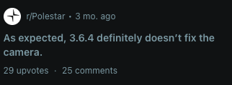
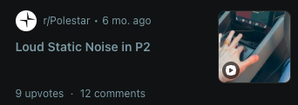
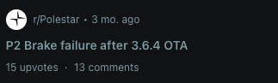
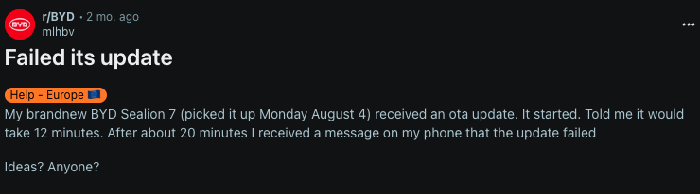
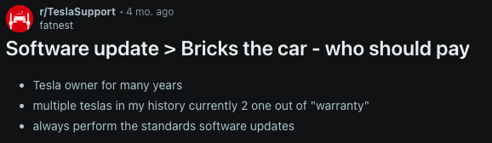
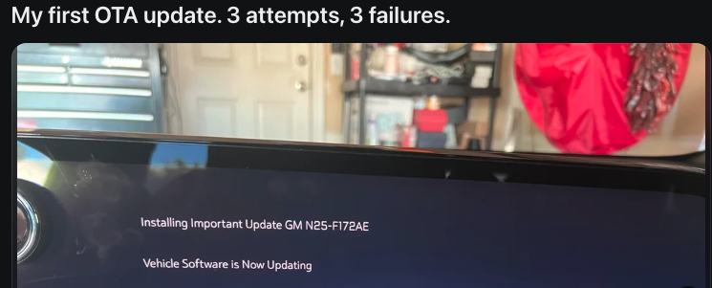
The Problem
INTERNAL
COPYRIGHT (C) 2025, ECLIPSE FOUNDATION
Notes:
"Hey everyone! We're the COOTA team, and we've built something incredible in just 48 hours!" "COOTA - Canary Orchestrator for Over-The-Air Updates. We're solving one of the biggest challenges in automotive: safe software updates at scale." "Meet our amazing team: João Chagas - Strategy & Vision João Barradas - Frontend Magic Gustavo Calonico - Backend Wizard Nuno Valente - Backend Genius Luis Varela - Backend Mastermind" "We've created a working prototype that's ready to demo!"

Slide 4
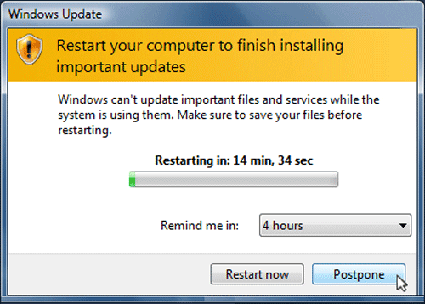
The Problem
“Updating a car today still feels like updating a PC from the 90s.”
INTERNAL
COPYRIGHT (C) 2025, ECLIPSE FOUNDATION
Notes:
"Hey everyone! We're the COOTA team, and we've built something incredible in just 48 hours!" "COOTA - Canary Orchestrator for Over-The-Air Updates. We're solving one of the biggest challenges in automotive: safe software updates at scale." "Meet our amazing team: João Chagas - Strategy & Vision João Barradas - Frontend Magic Gustavo Calonico - Backend Wizard Nuno Valente - Backend Genius Luis Varela - Backend Mastermind" "We've created a working prototype that's ready to demo!"

Slide 5
The Problem
Update flows to verification and decision-making during software deployment
Pain points
Too many manual steps
Fragmentation across suppliers and systems
High risk of failure (bricking, complex rollback)
Why it Matters
Automakers: slow time-to-market, high costs, risk of recalls.
End-users: poor experience, low trust in connected vehicles.
INTERNAL
COPYRIGHT (C) 2025, ECLIPSE FOUNDATION
Notes:
"Hey everyone! We're the COOTA team, and we've built something incredible in just 48 hours!" "COOTA - Canary Orchestrator for Over-The-Air Updates. We're solving one of the biggest challenges in automotive: safe software updates at scale." "Meet our amazing team: João Chagas - Strategy & Vision João Barradas - Frontend Magic Gustavo Calonico - Backend Wizard Nuno Valente - Backend Genius Luis Varela - Backend Mastermind" "We've created a working prototype that's ready to demo!"

Slide 6

INTERNAL
COPYRIGHT (C) 2025, ECLIPSE FOUNDATION

Slide 7

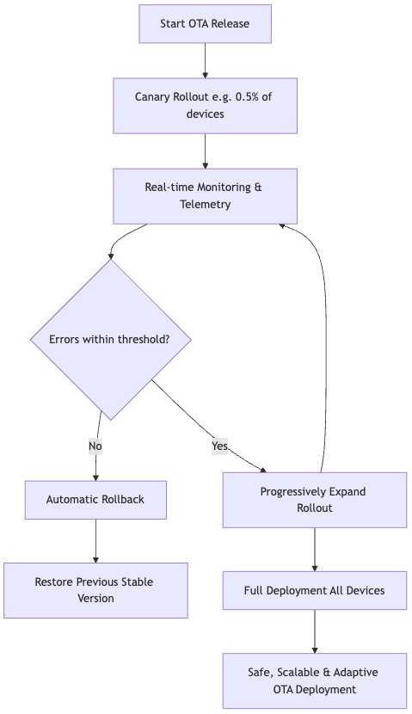
The Solution
COOTA – Canary Orchestrator for OTA Updates
Symphony SDV provides the framework
COOTA plugs into that framework as the orchestrator of OTA campaigns
Symphony SDV focuses on abstraction and standardization
COOTA adds deployment intelligence
canary updates
monitoring
rollback
safe scaling
Symphony SDV ensures interoperability between OEMs and suppliers.
COOTA ensures operational safety and trust in the actual OTA delivery flow
Symphony SDV provides the “what” (update capability)
COOTA provides the “how” (safe, scalable, adaptive rollout)
INTERNAL
COPYRIGHT (C) 2025, ECLIPSE FOUNDATION

Slide 8
The Solution
DEMO VIDEO HERE
INTERNAL
COPYRIGHT (C) 2025, ECLIPSE FOUNDATION

Slide 9
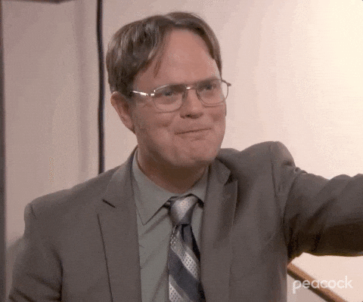
The Solution
INTERNAL
COPYRIGHT (C) 2025, ECLIPSE FOUNDATION

Slide 10
